Slide 1
BIOS27815: Infectious Diseases
Introduction to SARS-CoV-2 in Global Health
UChicago Center in Paris
Paris, France
January 2025

Slide 2
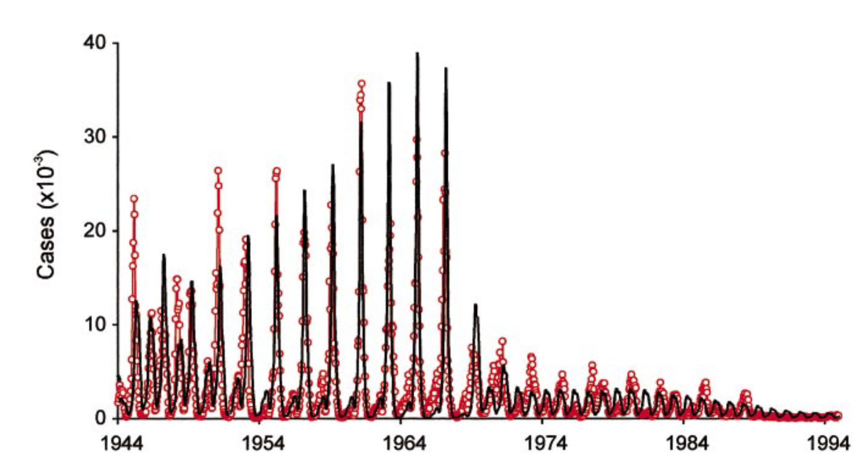
But first! …Biennial measles cycles from build-up of susceptible kids through births
measles vaccine introduced, 1965
Shift towards more frequent cycling in post-vaccination era. Dynamics more difficult to predict.
model
data
Biennial cycles in pre-vaccine era measles cases in London
Grenfell et al. 2002. Ecological Monographs

Slide 3
Goals for this lecture
To refresh our understanding of zoonotic diseases
To place SARS-CoV-2 in the broad context of coronaviruses in general
To introduce the role of bats as zoonotic reservoirs
To learn about the expansion of NGS capacity in LMICs after COVID-19
To identify socio-economic disparities in intervention (e.g. vaccine) access highlighted by COVID-19

Slide 4
Goals for this lecture
To refresh our understanding of zoonotic diseases
To place SARS-CoV-2 in the broad context of coronaviruses in general
To introduce the role of bats as zoonotic reservoirs
To learn about the expansion of NGS capacity in LMICs after COVID-19
To identify socio-economic disparities in intervention (e.g. vaccine) access highlighted by COVID-19

Slide 5

Zoonosis is the transmission of a pathogen from a wildlife reservoir host to a human target host population.
maintenance
population
(> critical community size, CCS)
human population
non-maintenance population
(< CCS)
reservoir population
Lembo et al. 2008. Journal of Animal Ecology
Haydon et al. 2002. Emerging Infectious Diseases.

Slide 6
Zoonosis is the transmission of a pathogen from a wildlife reservoir host to a human target host population.
maintenance
population
(> critical community size, CCS)
human population
non-maintenance population
(< CCS)
Can occur directly (e.g. SARS-CoV-2, rabies), or via vector (e.g. plague)
Animal hosts are not vectors!
reservoir population
Lembo et al. 2008. Journal of Animal Ecology
Haydon et al. 2002. Emerging Infectious Diseases.

Slide 7


Zoonosis is the transmission of a pathogen from a wildlife reservoir host to a human target host population.
maintenance
population
(> critical community size, CCS)
human population
non-maintenance population
(< CCS)
example: rabies
reservoir population
Lembo et al. 2008. Journal of Animal Ecology
Haydon et al. 2002. Emerging Infectious Diseases.

Slide 8

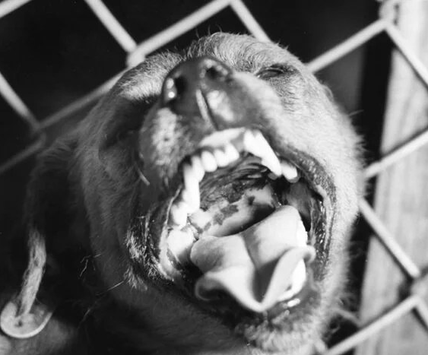
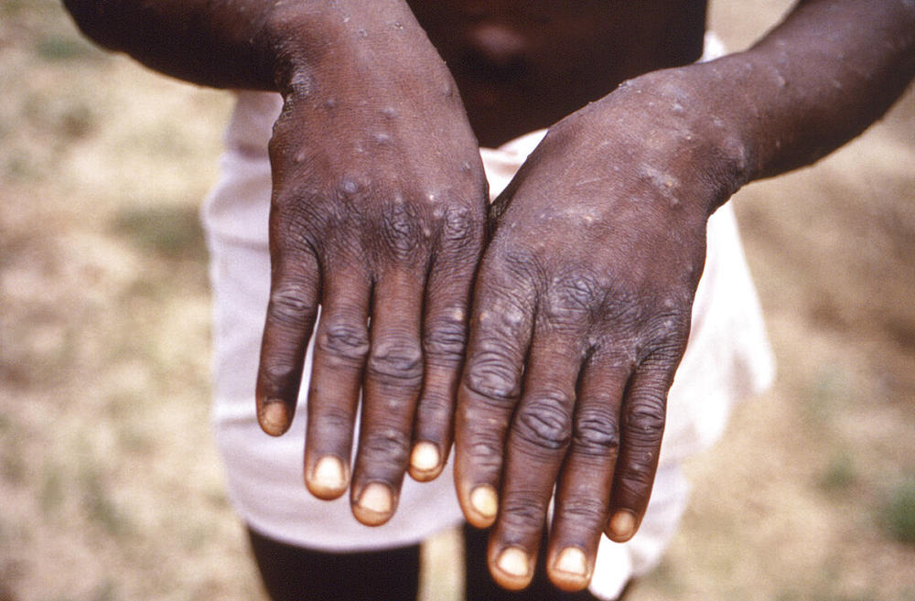
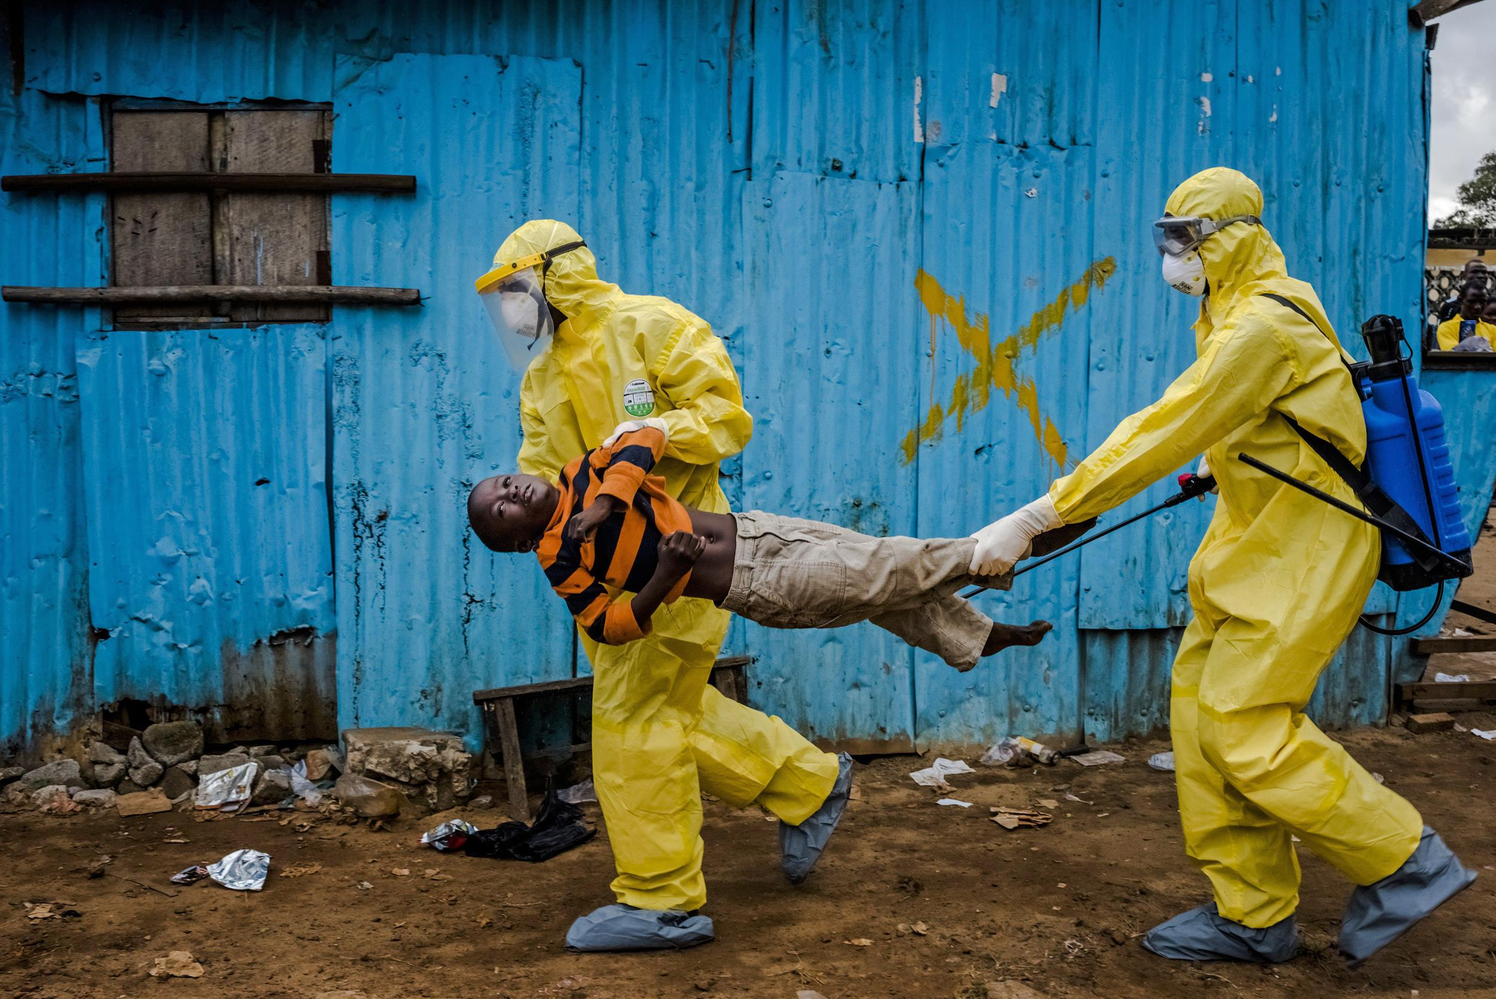
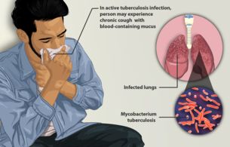
Pathogens can be classed according to their host relationships.
Stage I
Stage II
Stage III
Stage IV
Stage V
Transmits exclusively in humans
Transmits exclusively in animals
Human cases from spillovers only
Stuttering chains of transmission in humans
Sustained transmission and human outbreaks
canine parvovirus
rabies virus
monkeypox (pre-2022)
Ebola virus (especially post-2014)
Tuberculosis
Lloyd-Smith et al. 2009. Science.

Slide 9
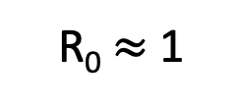
Pathogens can be classed according to their host relationships.
Stage I
Stage II
Stage III
Stage IV
Stage V
Transmits exclusively in humans
Transmits exclusively in animals
Human cases from spillovers only
Stuttering chains of transmission in humans
Sustained transmission and human outbreaks
canine parvovirus
rabies virus
monkeypox (pre-2022)
Ebola virus (especially post-2014)
Tuberculosis
R₀ < 1
R₀ $≈$ 1
R₀ > 1
Zoonotic pathogens can be classed according to their R₀ in humans.
Lloyd-Smith et al. 2009. Science.

Slide 10
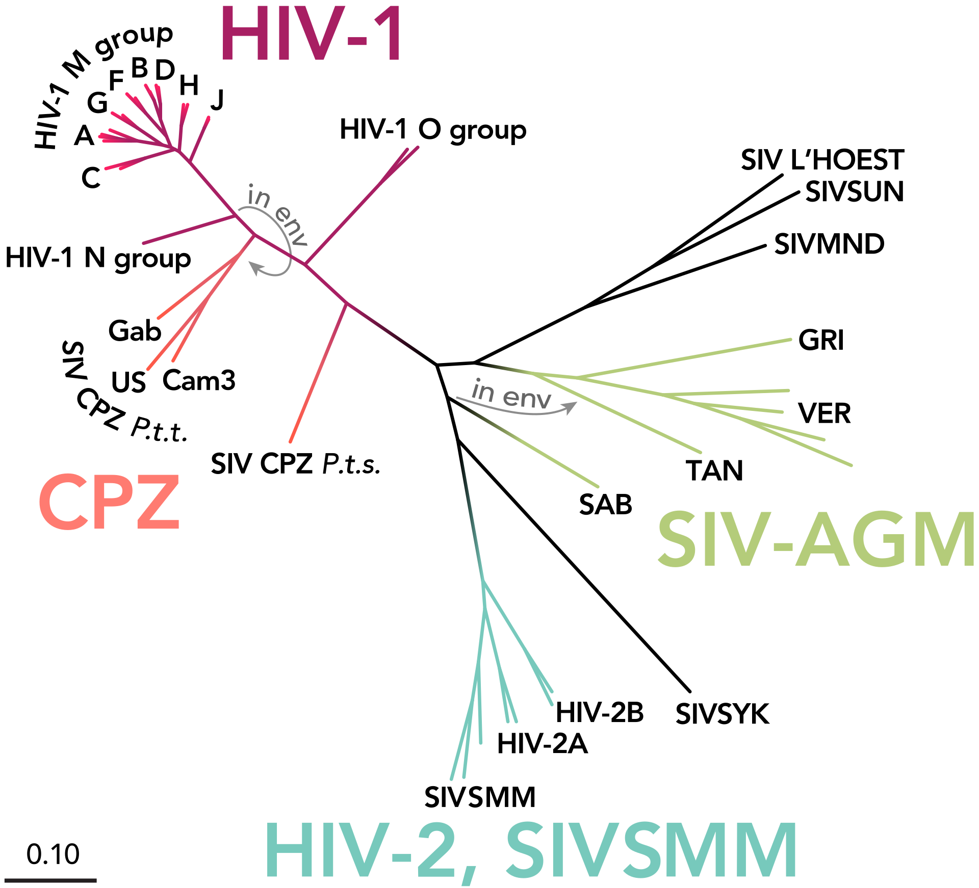
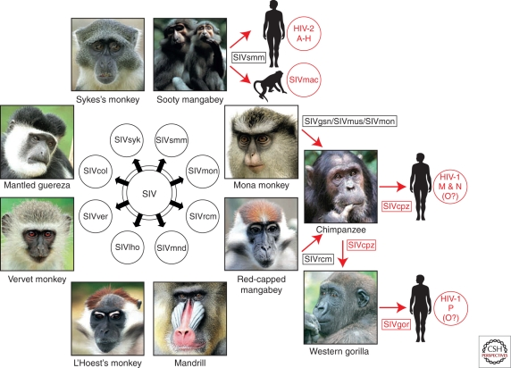
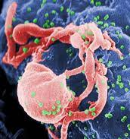
Most stage V pathogens once had an animal origin, as well!
Stage V
Transmits exclusively in humans
HIV
Sharp & Hahn. 2011. Cold Spring Harb Perspect Med.

Slide 11
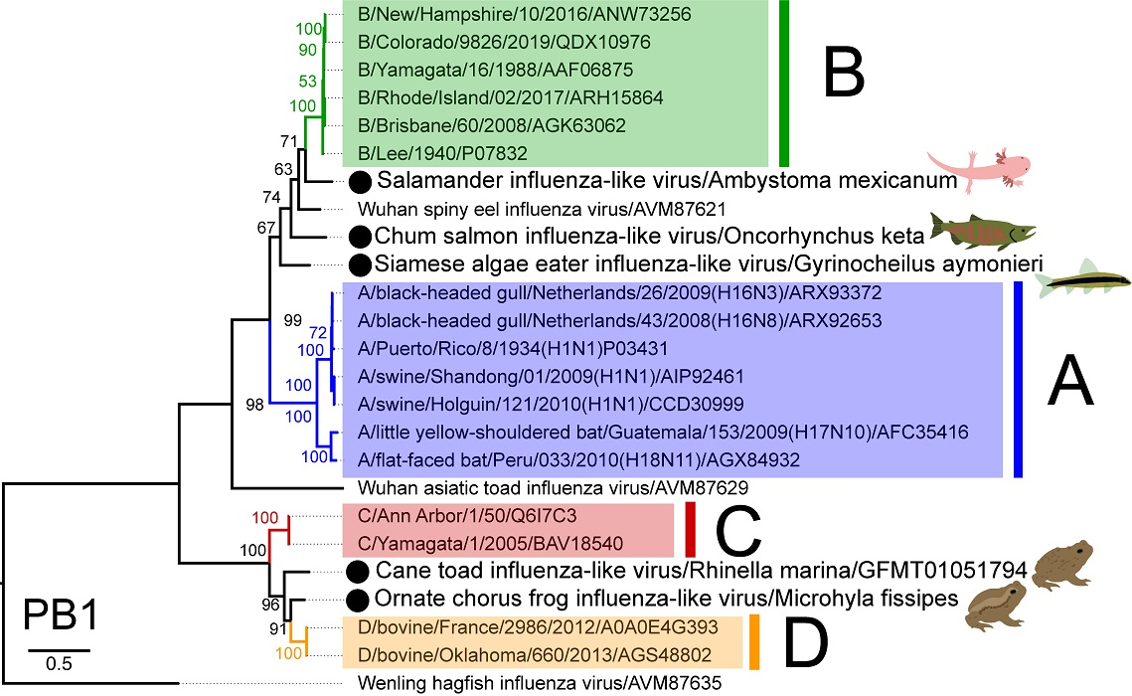
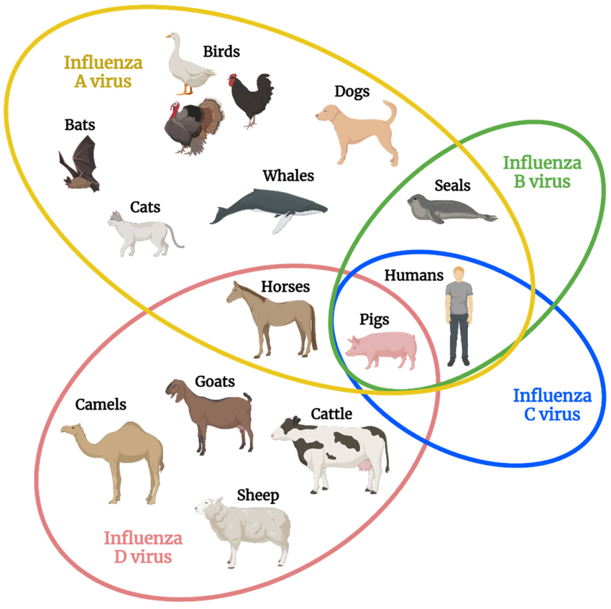
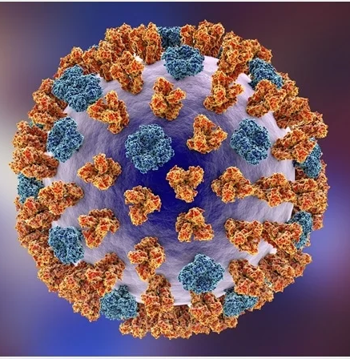
Most stage V pathogens once had an animal origin, as well!
Parry et al. 2020. Viruses.
Transmits exclusively in humans
Stage V
Influenza
Skelton & Huber. 2022. Viruses.

Slide 12
Goals for this lecture
To refresh our understanding of zoonotic diseases
To place SARS-CoV-2 in the broad context of coronaviruses in general
To introduce the role of bats as zoonotic reservoirs
To learn about the expansion of NGS capacity in LMICs after COVID-19
To identify socio-economic disparities in intervention (e.g. vaccine) access highlighted by COVID-19

Slide 13

SARS-CoV-2 originates from bat-borne coronaviruses in subgenus Sarbecovirus
Ravelomanantsoa, Guth, Andrianiaina, Andry, Gentles, Ranaivoson, & Brook.
2020. Emerging Topics in Life Sciences.

Slide 14
SARS-CoV-2 originates from bat-borne coronaviruses in subgenus Sarbecovirus
Ravelomanantsoa, Guth, Andrianiaina, Andry, Gentles, Ranaivoson, & Brook.
2020. Emerging Topics in Life Sciences.

Slide 15
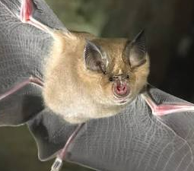
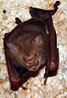
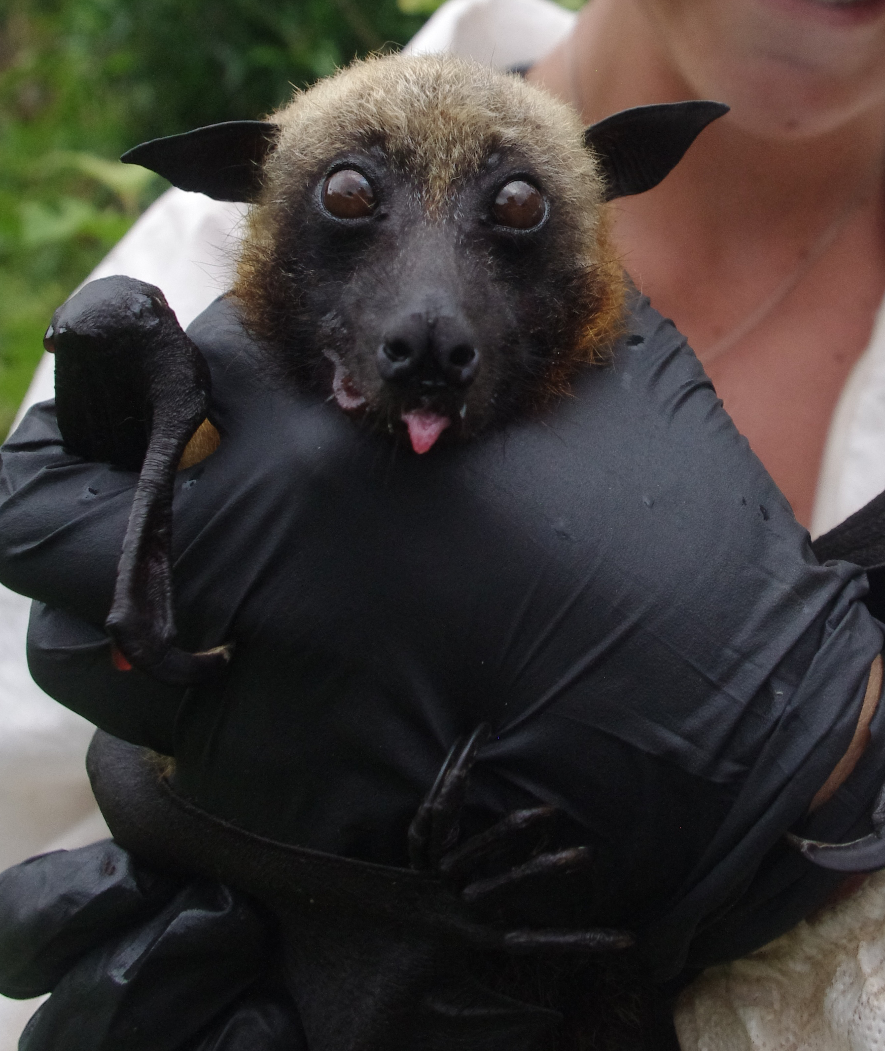
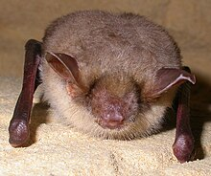
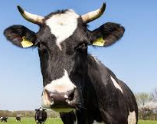
Because of coevolution, different animal host groups are associated with different BetaCoV subgenera
Rhinolophidae bats
Hipposiderae bats
Pteropodidae bats
Vespertillionidae bats
Cattle and Rodents
Ravelomanantsoa, Guth, Andrianiaina, Andry, Gentles, Ranaivoson, & Brook.
2020. Emerging Topics in Life Sciences.

Slide 16
CoVs are among the most likely viruses to ‘host-switch’
Ravelomanantsoa, Guth, Andrianiaina, Andry, Gentles, Ranaivoson, & Brook.
2020. Emerging Topics in Life Sciences.

Slide 17
CoVs are among the most likely viruses to ‘host-switch’
DPP4
Several features of CoV biology enhance their capacity to overcome barriers to cross-species emergence.
Cell Entry
Replication
Ravelomanantsoa, Guth, Andrianiaina, Andry, Gentles, Ranaivoson, & Brook.
2020. Emerging Topics in Life Sciences.

Slide 18
Goals for this lecture
To refresh our understanding of zoonotic diseases
To place SARS-CoV-2 in the broad context of coronaviruses in general
To introduce the role of bats as zoonotic reservoirs
To learn about the expansion of NGS capacity in LMICs after COVID-19
To identify socio-economic disparities in intervention (e.g. vaccine) access highlighted by COVID-19

Slide 25
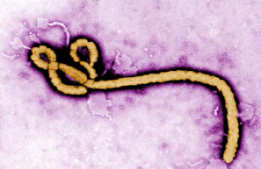
A virus will evolve to maximize its capacity for between-host infections.
transmission
Anderson and May 1982. Parasitology
Notes:
Typically, we predict that a virus will evolve traits that maximize its capacity for reproducing itself by infecting new hosts, achieving a baseline viral density within a single individual that produces sufficient virions in excretia – like the cough shown here – to go on to infect new hosts

Slide 26
A virus will evolve to maximize its capacity for between-host infections.
high
virulence
transmission
Mechanisms that promote transmission may also cause virulence to the host.
Anderson and May 1982. Parasitology
Notes:
Typically, we predict that a virus will evolve traits that maximize its capacity for reproducing itself by infecting new hosts, achieving a baseline viral density within a single individual that produces sufficient virions in excretia – like the cough shown here – to go on to infect new hosts

Slide 27
Bats accrue less virulence for a given level of transmission.
A virus will evolve to maximize its capacity for between-host infections.
high
virulence
transmission
Mechanisms that promote transmission may also cause virulence to the host.
Brook et al. 2023. PLoS Biology
Notes:
Typically, we predict that a virus will evolve traits that maximize its capacity for reproducing itself by infecting new hosts, achieving a baseline viral density within a single individual that produces sufficient virions in excretia – like the cough shown here – to go on to infect new hosts

Slide 28
Bats accrue less virulence for a given level of transmission.
A virus will evolve to maximize its capacity for between-host infections.
high
virulence
transmission
minimal virulence
equal transmission
Mechanisms that promote transmission may also cause virulence to the host.
Brook et al. 2023. PLoS Biology
Notes:
Typically, we predict that a virus will evolve traits that maximize its capacity for reproducing itself by infecting new hosts, achieving a baseline viral density within a single individual that produces sufficient virions in excretia – like the cough shown here – to go on to infect new hosts

Slide 29
Bats accrue less virulence for a given level of transmission.
A virus will evolve to maximize its capacity for between-host infections.
high
virulence
transmission
minimal virulence
equal transmission
Mechanisms that promote transmission may also cause virulence to the host.
Viruses may evolve traits that cause high virulence in non-bats.
Brook et al. 2023. PLoS Biology
Notes:
Typically, we predict that a virus will evolve traits that maximize its capacity for reproducing itself by infecting new hosts, achieving a baseline viral density within a single individual that produces sufficient virions in excretia – like the cough shown here – to go on to infect new hosts

Slide 30
Goals for this lecture
To refresh our understanding of zoonotic diseases
To place SARS-CoV-2 in the broad context of coronaviruses in general
To introduce the role of bats as zoonotic reservoirs
To learn about the expansion of NGS capacity in LMICs after COVID-19
To identify socio-economic disparities in intervention (e.g. vaccine) access highlighted by COVID-19

Slide 31
COVID-19 has hastened the expansion of pathogen genomic sequencing in Africa
Tegally et al. 2022. Science.

Slide 32
COVID-19 has hastened the expansion of pathogen genomic sequencing in Africa
Tegally et al. 2022. Science.

Slide 33
COVID-19 has hastened the expansion of pathogen genomic sequencing in Africa
Tegally et al. 2022. Science.

Slide 34
In-country sequencing expanded throughout the pandemic and improved turnaround time (TAT)
Tegally et al. 2022. Science.

Slide 35
In-country sequencing expanded throughout the pandemic and improved turnaround time (TAT)
Tegally et al. 2022. Science.

Slide 36
In-country sequencing expanded throughout the pandemic and improved turnaround time (TAT)
Tegally et al. 2022. Science.

Slide 37
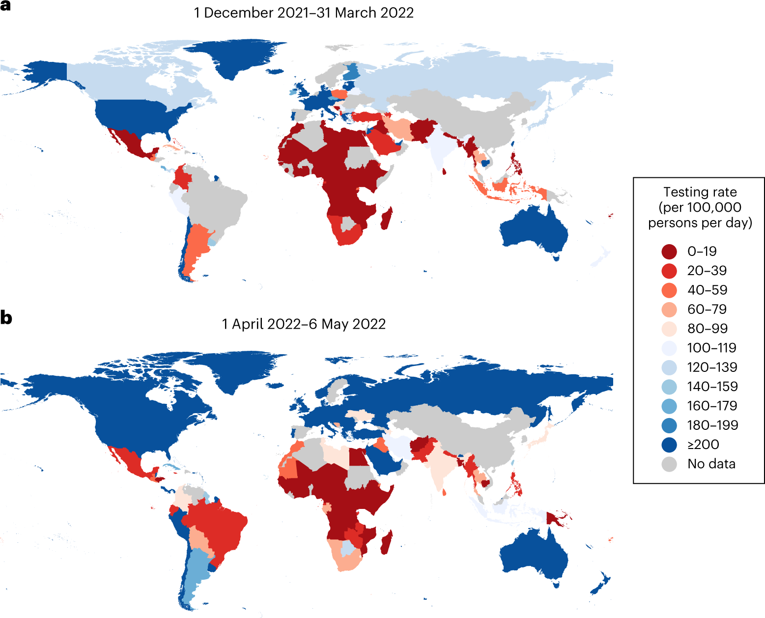
Testing rates drive sequencing rates and remain low in many LMICs as compared to HICs.
Han et al. 2023. Nature Genetics.

Slide 38
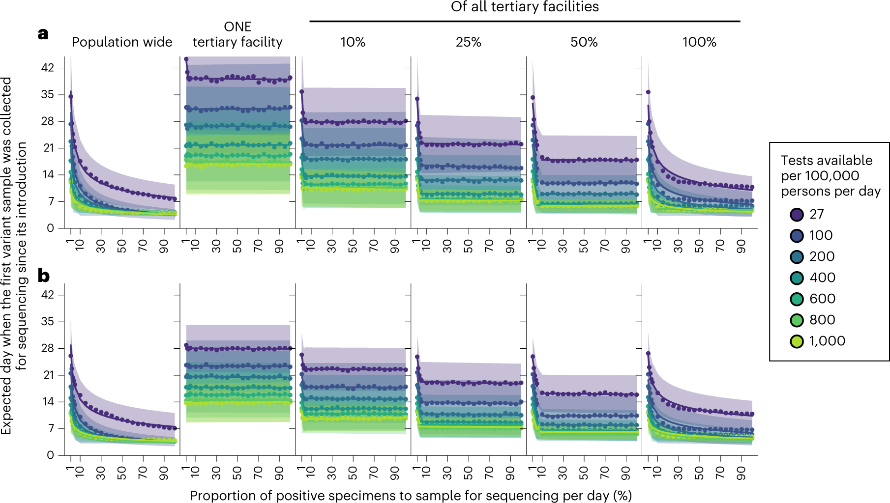
Testing rates and sequencing rates combine to capture the effectiveness of genomic surveillance programs.
wild-type SARS-CoV-2
Omicron / Delta
Han et al. 2023. Nature Genetics.

Slide 39
Testing rates and sequencing rates combine to capture the effectiveness of genomic surveillance programs.
wild-type SARS-CoV-2
Why do
we see differences by variant?
Omicron / Delta
Han et al. 2023. Nature Genetics.

Slide 40
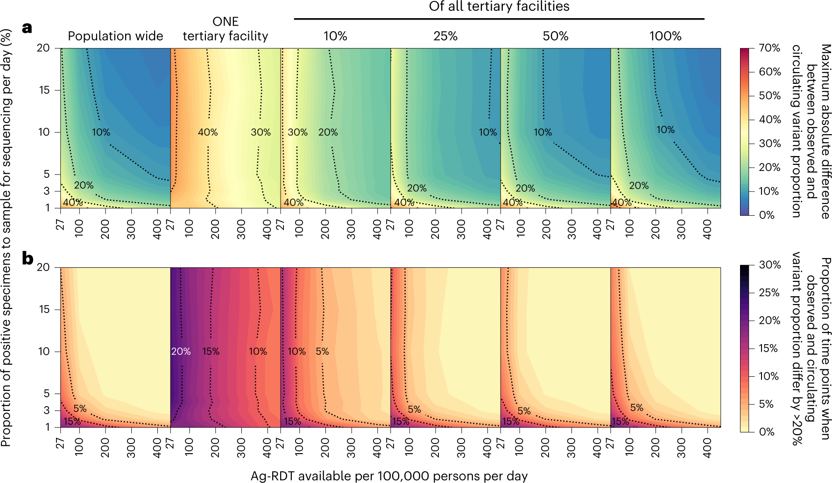
Testing rates and sequencing rates combine to capture the effectiveness of genomic surveillance programs.
Han et al. 2023. Nature Genetics.
Notes:
all results were computed from 1,000 random independent simulations for each surveillance strategy.

Slide 41
Goals for this lecture
To refresh our understanding of zoonotic diseases
To place SARS-CoV-2 in the broad context of coronaviruses in general
To introduce the role of bats as zoonotic reservoirs
To learn about the expansion of NGS capacity in LMICs after COVID-19
To identify socio-economic disparities in intervention (e.g. vaccine) access highlighted by COVID-19

Slide 42
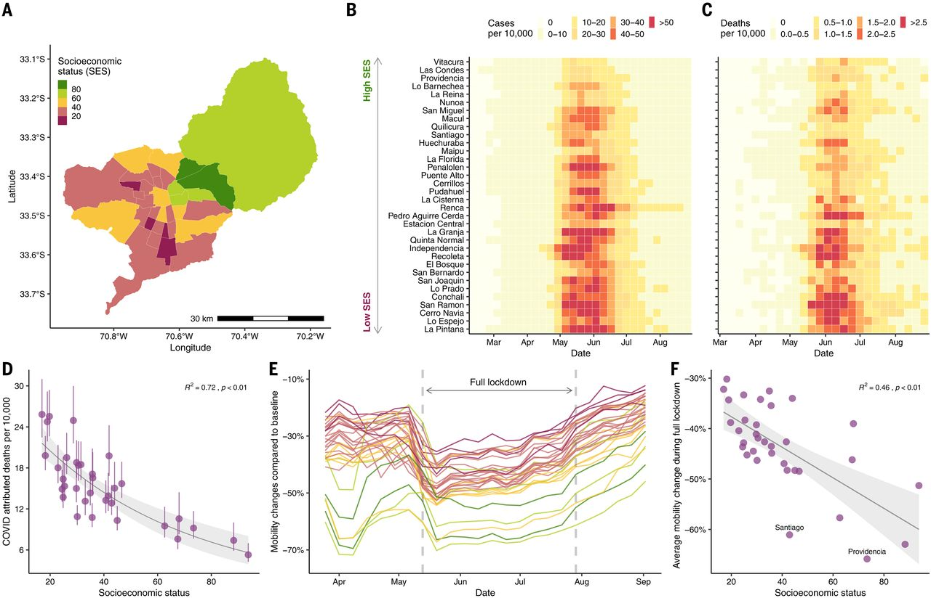
COVID-19 morbidity and mortality was more pronounced in more vulnerable populations globally.
Mena et al. 2021. Science.

Slide 43
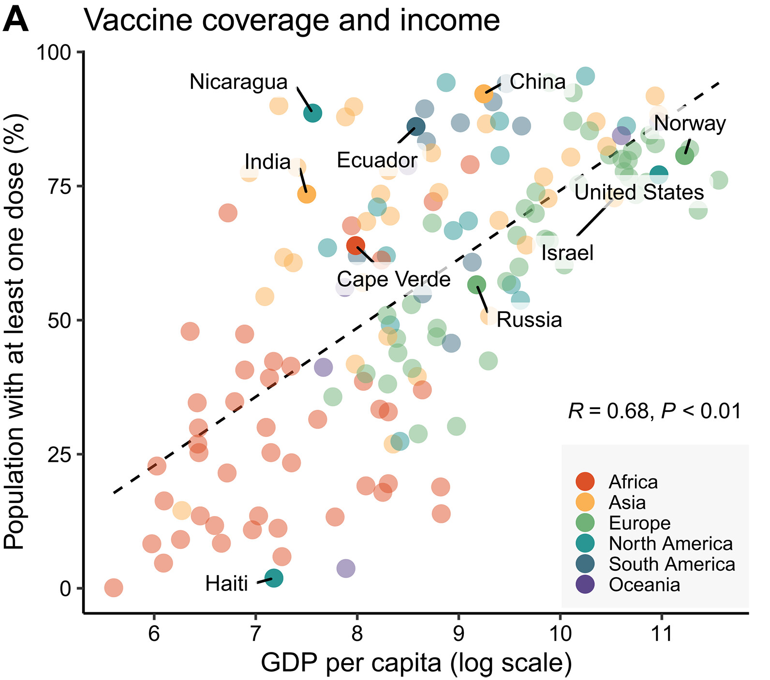
Global vaccination rates track GDP
Larsen et al. 2023. Scientific Advances.

Slide 44
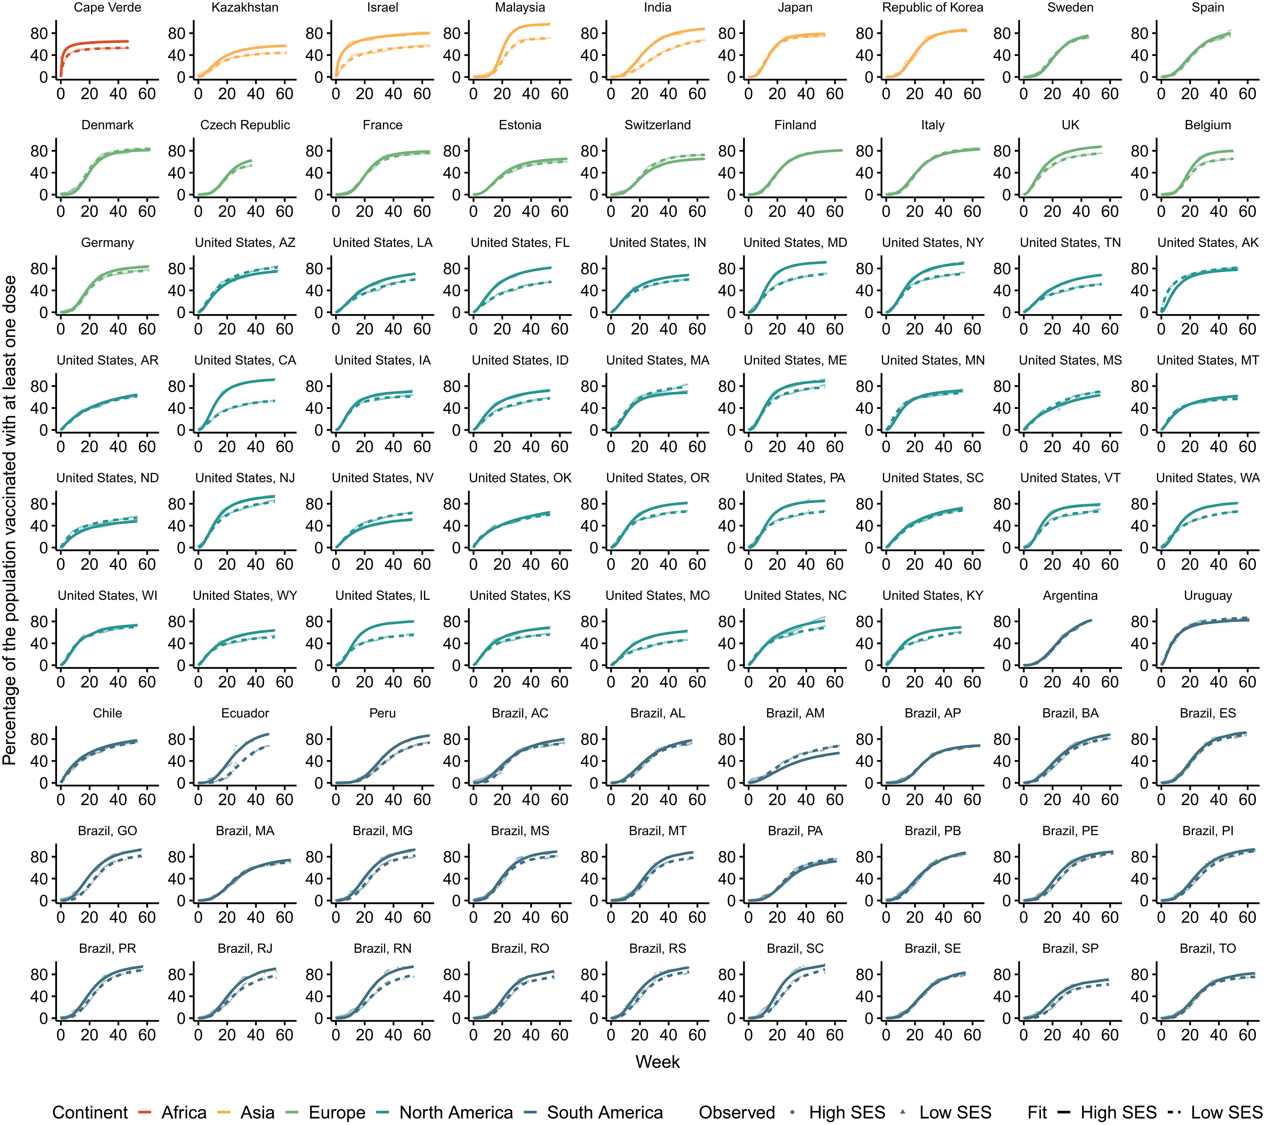
Global COVID-19 vaccine roll-out
Larsen et al. 2023. Scientific Advances.

Slide 45
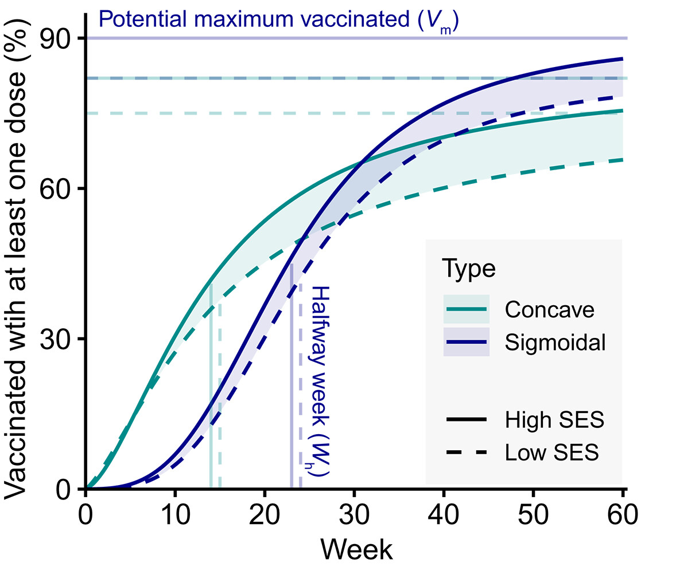
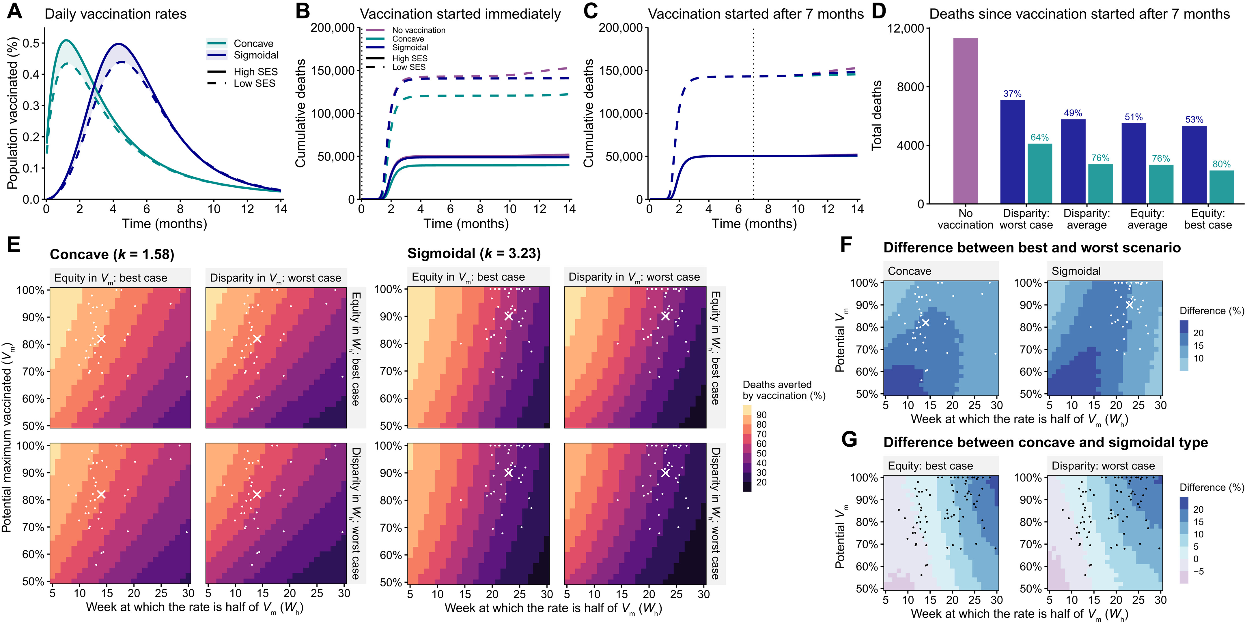
Two types of vaccination strategy identified
Larsen et al. 2023. Scientific Advances.

Slide 46
Faster responses (concave strategy) mitigate disparities and avert deaths
Larsen et al. 2023. Scientific Advances.

Slide 47
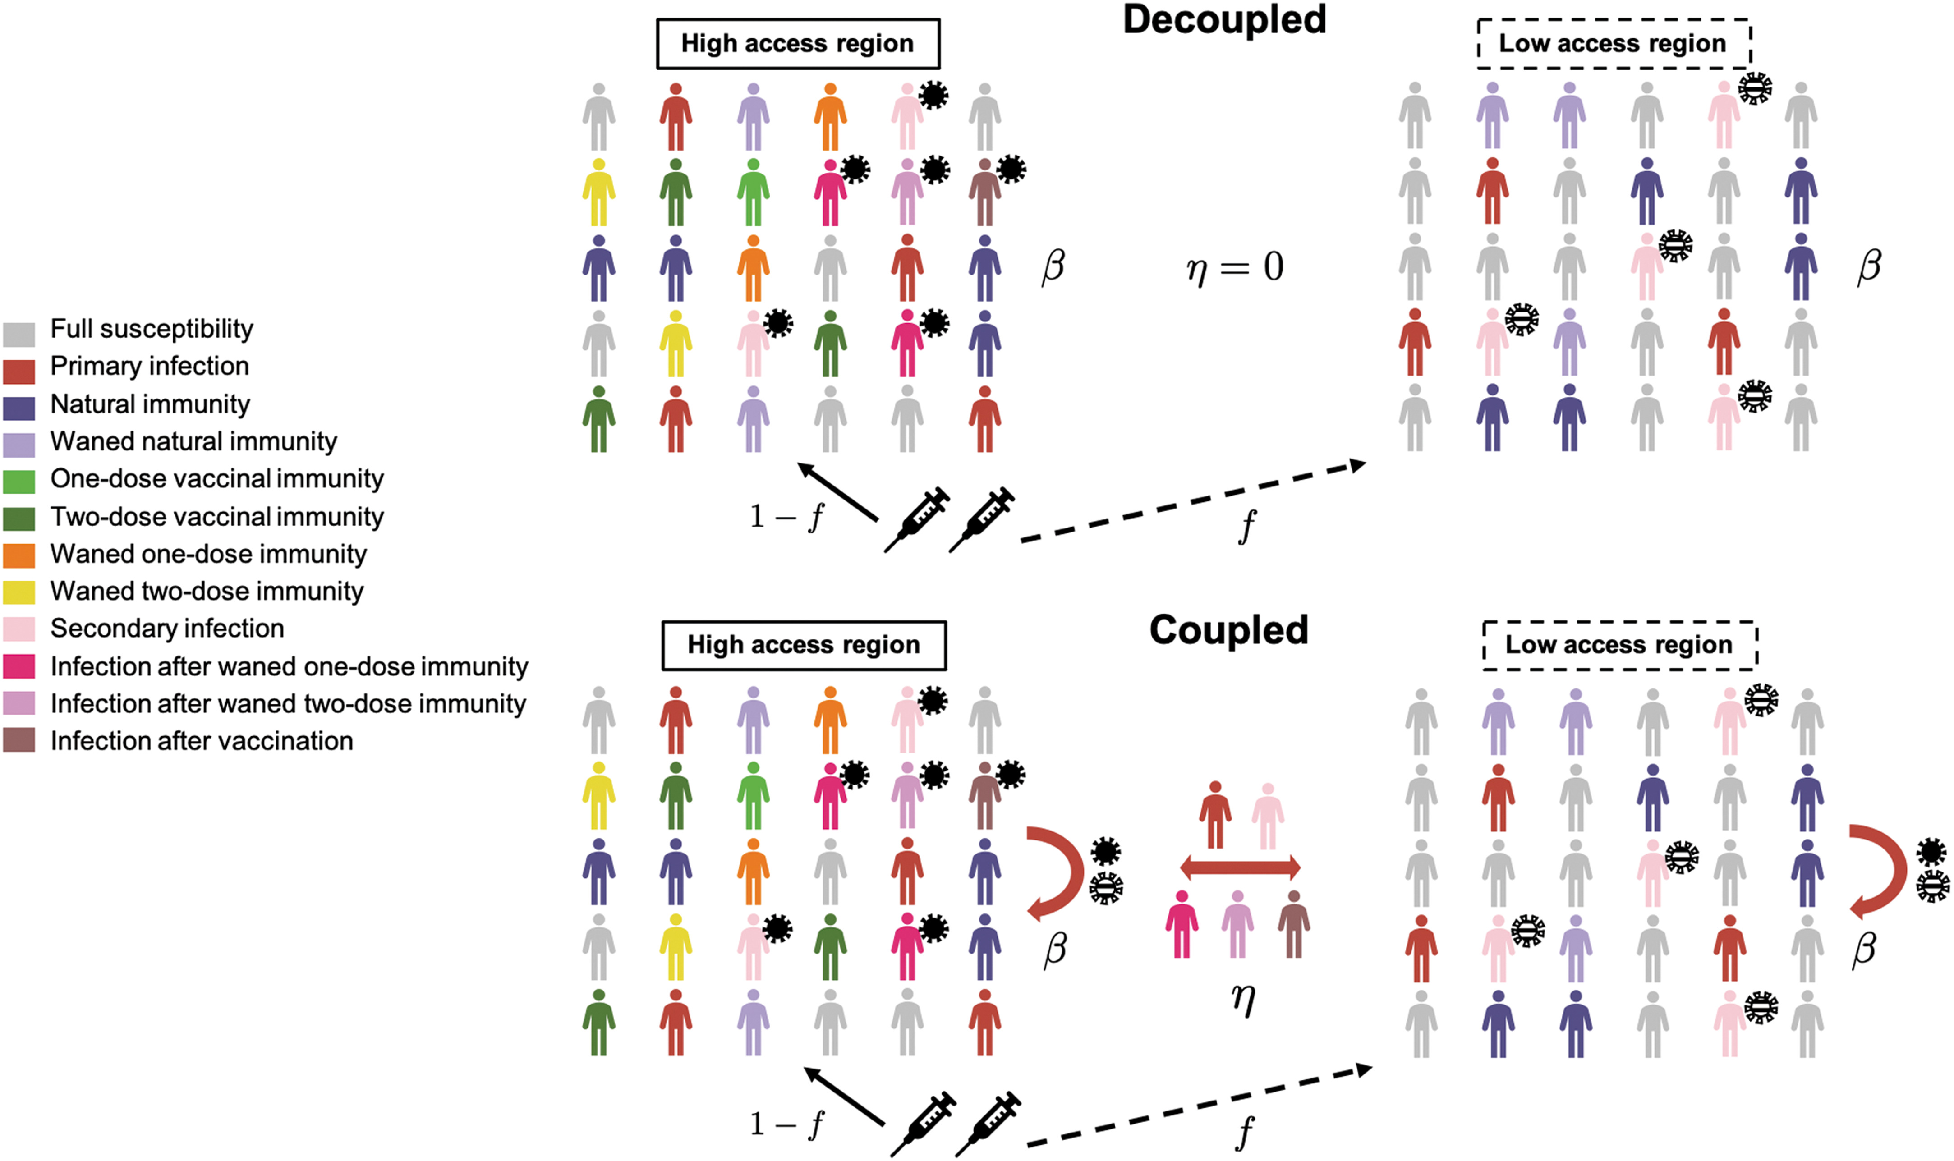
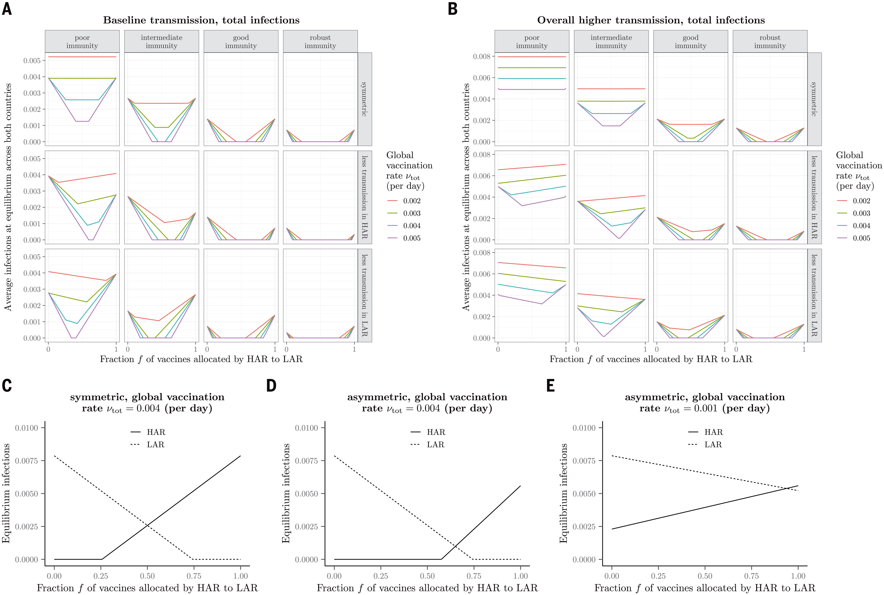
Consequences of vaccine stockpiling for epidemic dynamics
Average infections at equilibrium across both countries
Fraction of vaccines allocated by High Access Region to Low Access Region
Wagner & Saad-Roy et al. 2021. Science.

